Slide 1
Chapter 1
Networking: An Overview

Slide 2
Object
• Explain what a network is
• Understand basic networking concepts and terms
• Explain the advantages of using a network in a home
• Discuss the advantages of using a network in an office
• Determine boundaries between networks
• Describe network topologies
• Understand general network design concepts
• Design a simple LAN
http://fpt.edu.vn

Slide 3
The Simplest Network
Two nodes
One way transmission
Source
Node
Destination
Node
Like broadcast radio.
http://fpt.edu.vn

Slide 4
Making Things More Complex
Point to point or shared medium?
If shared, how do we make sure a message gets only to the intended recipient?
If you put a signal on a shared medium, everyone will see it!
http://fpt.edu.vn

Slide 5
Making Things More Complex
Each network stands alone or may they communicate or inter-network?
If we inter-network, how do we tell when the destination is on another network?
http://fpt.edu.vn

Slide 6
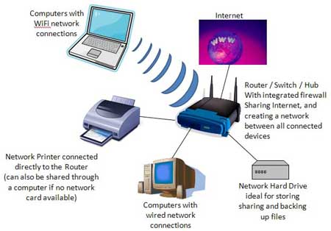
What Is a Network?
Computer network components
  Computer hardware and software
  Print devices
  Network Devices
System components linked using various media
  Copper wire
  Fiber-optic cables
  Radio waves
  Infrared waves
  Microwaves
Benefit of computer networks: information sharing
http://fpt.edu.vn

Slide 7
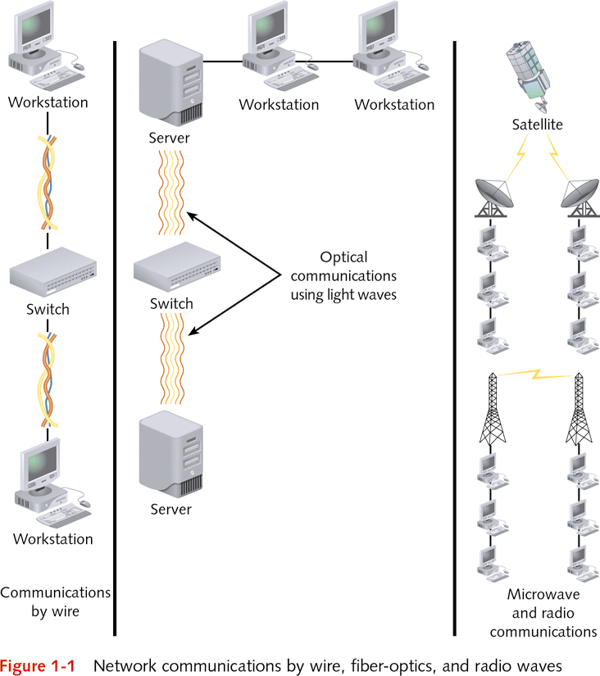
http://fpt.edu.vn

Slide 8
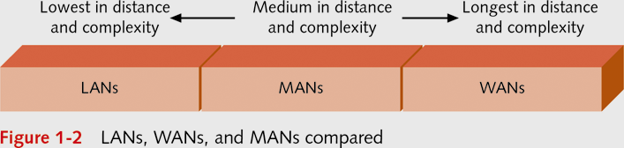
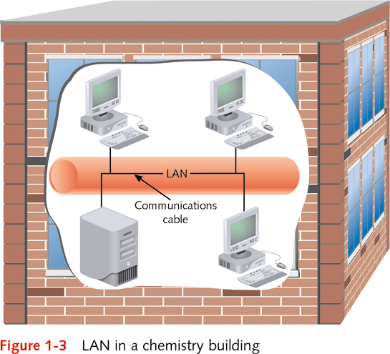
Understanding the Types of Networks
Three types of networks
  Local area networks (LANs)
  Metropolitan area networks (MANs)
  Wide area networks (WANs)
LAN
  Interconnects computers, printers, other equipment
  Consists of shared hardware and software resources in close physical proximity
  Example: University Chemistry Department
http://fpt.edu.vn

Slide 9
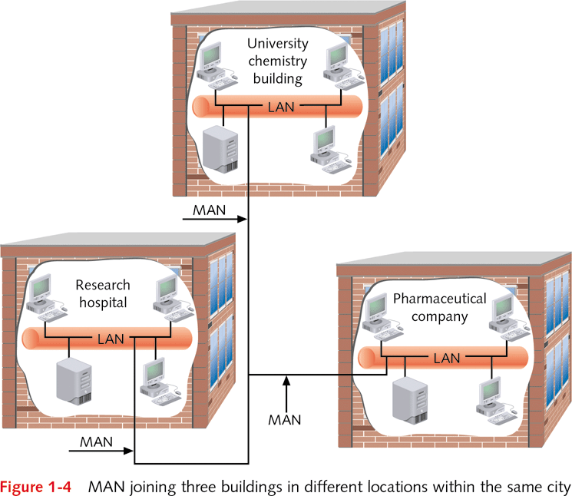
Understanding the Types of Networks (continued)
MAN (metropolitan area network)
  Spans a greater distance than a LAN
    Up to 48 kilometers (about 30 miles)
  Links multiple LANs within city or metropolitan region
    Typically uses fiber-optic/wireless connections
  LANs may be separately owned
  Example: Links to Chemistry building LAN
    Research hospital LAN
    Pharmaceutical company LAN
http://fpt.edu.vn

Slide 10
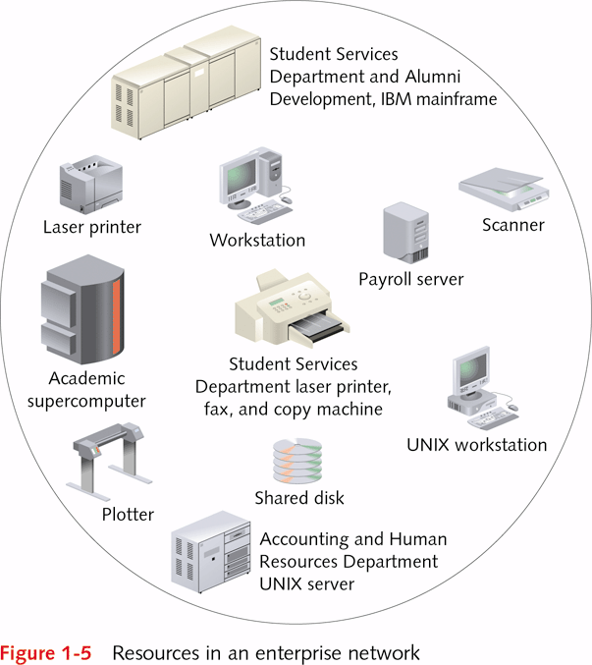
Understanding the Types of Networks (continued)
WAN (wide area network)
  Composed of two or more LANs or MANs
  Connected across distance greater than 48 km
  May have constituent LANs on different continents
Enterprise network
  Links different users across one or more organizations
  Provides variety of resources
  Used to fulfill business, research, educational tasks
  Typically consists of several LANs
  Example: Campus enterprise network
http://fpt.edu.vn

Slide 11
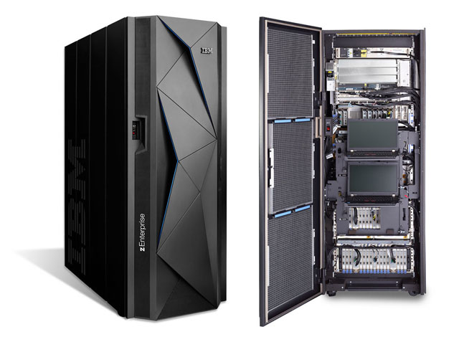
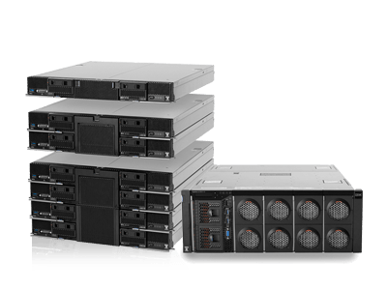
Using Basic Networking Terms
Node (or station): network component
  Personal computer, server, mainframe, minicomputer, printer, fax, CD-ROM array, disk array
Nodes linked through communications media
  Wire cabling, fiber-optic cables, radio or infrared waves
  Provides transmission of signals to and from nodes
Three network nodes important to users:
  Workstations
  Hosts
  Servers
http://fpt.edu.vn

Slide 12
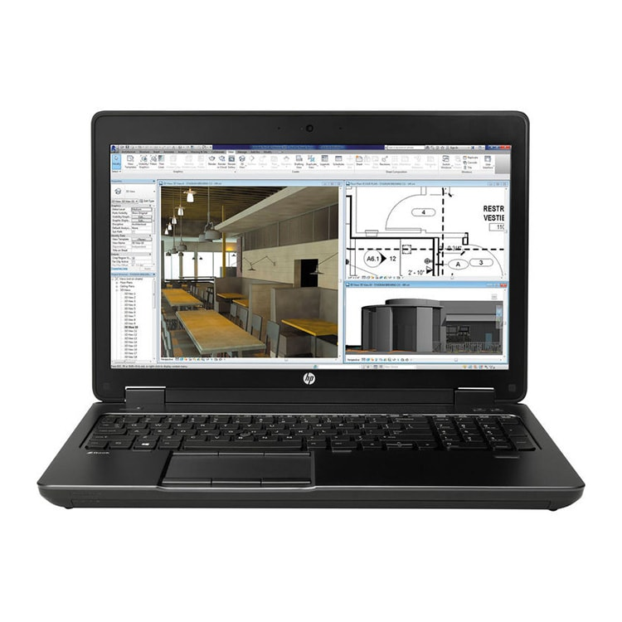
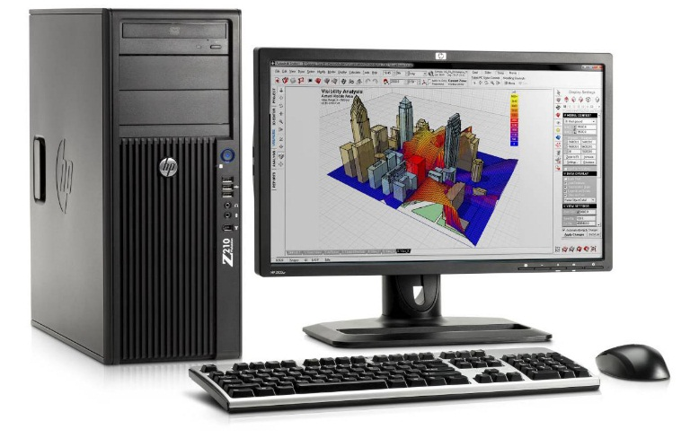
Using Basic Networking Terms (continued)
Workstation computer
  Has CPU (central processing unit) and operating system
  Home to local applications such as Microsoft Office
  Runs network applications to access data on server or mainframe
  May fulfill roles as client and host
Client: workstation accessing data or software on another computer
  Example: personal computer using Intel chip
Host: computer accessed for data or software
http://fpt.edu.vn

Slide 13
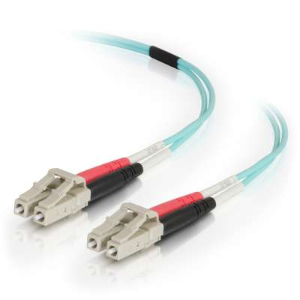
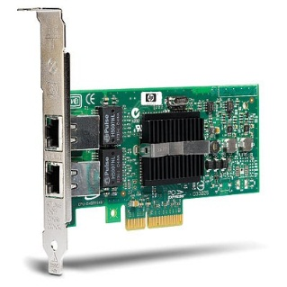
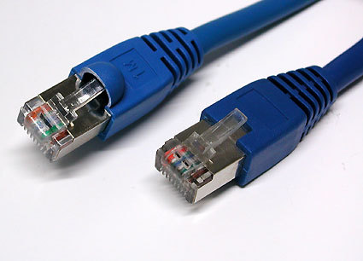
Using Basic Networking Terms (continued)
Servers
  Single computers offering multiuser access
  Repository for software applications and data files
  Host from two to as many as several thousand users
  Network operating system is key to capability
    Example: Microsoft Windows Server operating system
Network nodes attached to media through NIC
NIC (network interface card)
  Board installed in computer or network device
  Attached to communication media by connector or antenna
http://fpt.edu.vn

Slide 14
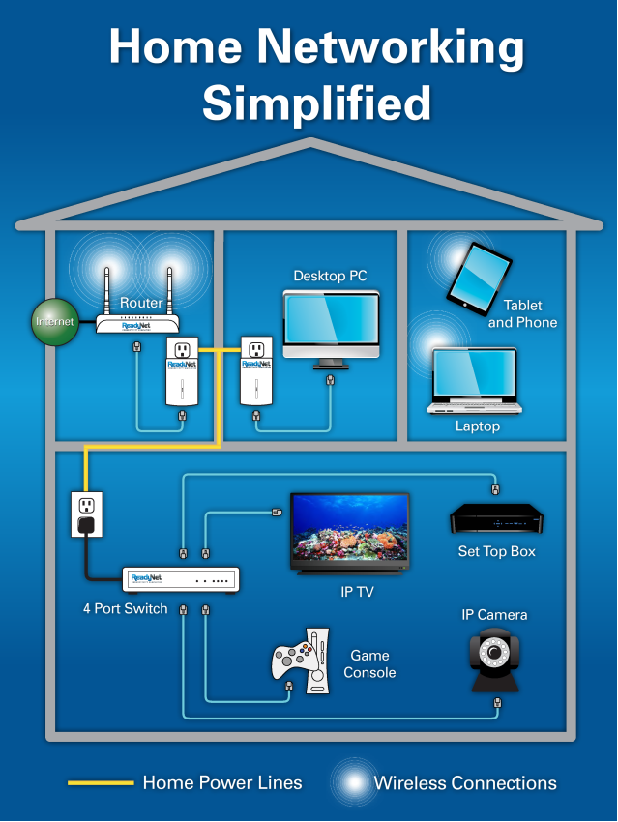
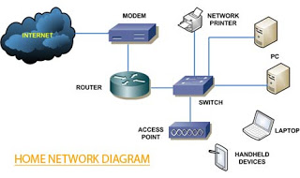
Using a Network in a Home
Networks enrich use of computers and digital services
Three prominent uses of home networks
  Sharing files and printers
  Accessing the Internet and entertainment resources
  Connecting home resources
    Computers, entertainment devices, appliances
http://fpt.edu.vn

Slide 15

Using a Network in a Office
http://fpt.edu.vn

Slide 16
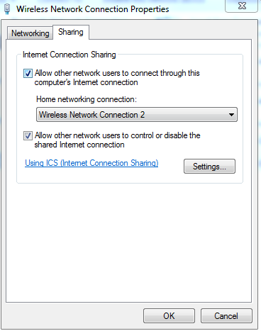
Connecting Computers for Sharing Files and Printers
Share files in home by connecting computers
  Example 1: Transfer files from laptop to desktop
  Example 2: Cross-computer file back-up
Three common ways to share printers
  Share workstation printer using operating system
    Caveat: no one can use printer if workstation off
  Attach printer directly to network using built-in NIC
  Utilize print server with multiple connections and NIC
    Plug one or more printers into print server
    Connect print server to network
http://fpt.edu.vn

Slide 17
Using a Network to Save Time and Money
Two ways networks save time and money
  Share information without leaving office
  Telecommute to office via home network
Example: accountant's meeting with client
  Compute taxes on networked computer
  Send tax documents to shared printer
  Editing and compiling done by associate
  Tax document returned to accountant
    Meeting continues uninterrupted
  Bill generated after meeting concludes
http://fpt.edu.vn

Slide 18
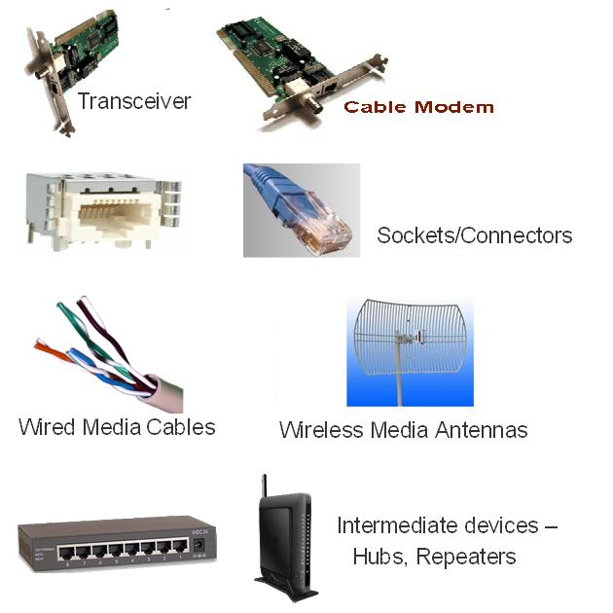
Identifying Network Boundaries
Distinguish network types using four properties
  Communications medium
  Protocol
  Topology
  Network type (private versus public)
Examining communications medium
  LAN boundaries based on communication medium changes
    Boundary 1: fiber-optic cables linking wire-cable LANs
    Boundary 2: medium change from fiber-optics to microwaves
http://fpt.edu.vn

Slide 19
Identifying Network Boundaries (continued)
Examining protocols
  Formatting and transmission of data
    Discrete units of data called packets or frames
  Change/addition to protocol often signals LAN boundary
  Example: Ethernet and token ring protocols
    Devices at boundary line convert frames or packets
Examining topology
  Two components
    Physical layout of network cables and devices
    Logical path followed by network packets or frames
  Example: Logical path of frames follows star pattern
http://fpt.edu.vn

Slide 20
Identifying Network Boundaries (continued)
Examining network types
  Often change at network boundary
  Example: beginning/end points of public and private networks
Private networks owned and operated by organization
Public networks offer services to public
Virtual private network (VPN)
  Private network tunnels through larger network
  Restricted to designated member clients
http://fpt.edu.vn

Slide 21
Network Topologies
Topology: physical layout combined with logical path
Cable plant: pattern of physical layout
  Wired networks: cabling laid in office, building, campus
  Wireless networks: types of antennas, devices, direction of transmission
Decentralized network layout
  Cable between each station on network
  Analogy: mountain climbers connected by a rope
Centralized network layout
  Each station physically connected to central device
  Analogy: star with workstation as its points
http://fpt.edu.vn

Slide 22
Network Topologies (continued)
Main topologies: bus, ring, star, and mesh
Hybrid topologies: star-bus, star-ring
Selecting topology for network
  Consider intended purpose
    Demand for network services
    Number and kinds of applications used
    Network traffic (number of frames to transmit)
    Connection to other networks
    Security needs
Network topology influences network growth potential
http://fpt.edu.vn

Slide 23
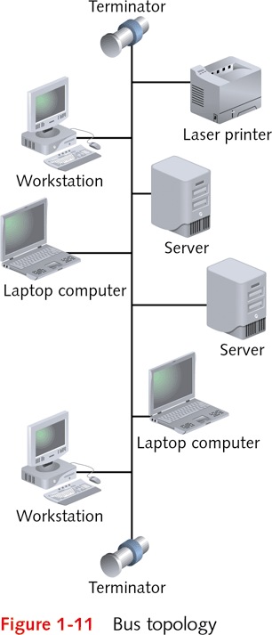
Bus Topology
Bus topology
  Consists of cables connecting PCs or file servers
  Visualizes connections as chain links
  Terminator attached to each end of bus cable segment
Transmitting packet across bus
  Detected by all nodes on segment
  Given time limit to reach destination
IEEE (Institute of Electrical and Electronics Engineers)
  Develops standards for network cabling, transmission
  Specifies length of bus segment
http://fpt.edu.vn

Slide 24
Bus Topology (continued)
Terminator signals end of physical segment
  Functions as resistor that absorbs signal
Terminator critical on bus networks
  Prevents signal reflection back on to covered path
Advantages of bus design
  Requires less cable than other topologies
  Easy to extend bus with a workstation
Disadvantages of bus topology
  High management costs
    Single defective node can take down entire network
  Can become quickly congested with network traffic
http://fpt.edu.vn

Slide 25
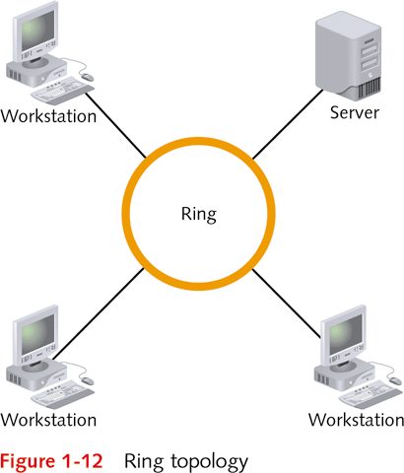
Ring Topology
Ring topology: continuous data path
  Workstations attached to cable at points around ring
Transmitting data across ring topology
  Goes around ring to reach destination
  Continues until ends at source node
Advantages to ring topology
  Easier to manage than bus
  Handles high volume network better than bus
  Suited to transmitting signals over long distances
Disadvantages to ring topology
  More expensive to implement than bus
  Fewer equipment options than bus
http://fpt.edu.vn

Slide 26
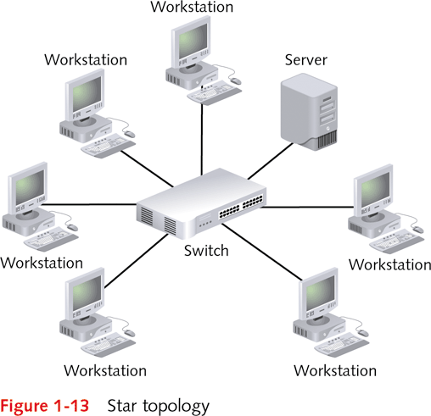
Star Topology
Star topology: multiple nodes attached to central device (hub, switch, router)
  Cable segments radiate from center like a star
  Example: workstations connected to switch
Advantages of star topology
  Start-up costs comparable to ring topology
  Easier to manage, defective nodes quickly isolated
  Easier to expand by connecting nodes or networks
  Offers better equipment and high-speed options
Disadvantages of star topology
  Failure of central device may cause network failure
  Requires more cable than bus
http://fpt.edu.vn

Slide 27
Star-Bus Hybrid Topology
Star-bus (star-wired) topology
  Each radiating finger is separate logical bus segment
  Each segment terminated at both ends
Advantages of star-bus topology
  No exposed terminators
  Connect multiple central devices to expand network
  Connection between central devices is a backbone
    Backbone enables high-speed communication
  Central devices have built-in intelligence
  Many equipment and high-speed options available
http://fpt.edu.vn

Slide 28
Star-Ring Hybrid Topology
Star-ring (star-wired) topology
  Hub or access unit acts as linking device
  Transmission using logical communication of ring
  No need for built-in terminators
http://fpt.edu.vn

Slide 29
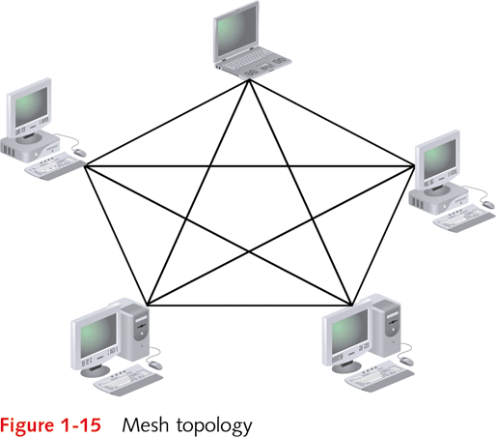
Mesh Topology
Mesh topology
  Every node connected to every other node in network
  Provides network with fault tolerance
    Fault tolerance: built-in protection against failure
    If link breaks, nodes can still communicate
  Alternate communication paths increase as number of nodes increase
Mesh topology used less on LANs
  Expensive to implement
Mesh topology often used in MANs and WANs
http://fpt.edu.vn

Slide 30
Network Design Introduction
Step 1: Understand protocols, access methods, topologies
  Example: Telecommunications-based WAN vs. satellite-based WAN
Step 2: Understand physical equipment used
  Example: Different media for backbone and internal network
Step 3: Understand basic network design principles
  Structured wiring and networking
  Designing for multimedia and client/server applications
  Taking advantage of LAN and WAN characteristics
http://fpt.edu.vn

Slide 31
Network Design Introduction (continued)
Step 4: Assess nature of home, office, organization
  Types of computers used as well as location
  Software applications used and resources required
  Patterns in organization relative to network use
  High and low network use periods
  How to simplify troubleshooting and maintenance
  Determine security need for the network
  Anticipate how growth affects network resources
http://fpt.edu.vn

Slide 32
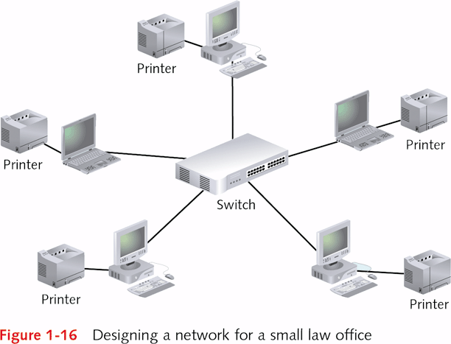
Designing a Simple LAN
Scenario: Office with four lawyers, one secretary
Four components of solid design
  Star-bus hybrid topology
  Switch connecting computes in middle of star layout
  Share certain information on network
  Share printers on network
Rationale for design
  Star-bus economical to implement and maintain
  Use of switch satisfies need for fast communication
  Resource sharing using peer-to-peer network
  Internet access easily added
http://fpt.edu.vn

Slide 33
Q & A
http://fpt.edu.vn

